Slide 1

Microsoft Word Home Tab: Essential Groups and Their Uses
Discover the five powerful groups that make the Home tab your go-to productivity center in Microsoft Word.

Slide 2

Clipboard Group: The Power of Copy & Paste
Cut, Copy & Paste
Move and duplicate text, images, and objects effortlessly across documents and applications.
Format Painter
Copy formatting from one section and apply it instantly to another, ensuring consistent styling throughout.
Why It Matters: Saves precious time and ensures uniform document appearance across all your content.

Slide 3

Font Group: Control Your Text's Look
Text Styling Tools
Change font type, size, and color
Apply bold, italic, and underline styles
Add text effects like highlighting
Adjust case and clear unwanted formatting
Impact: Transforms plain text into visually appealing, readable content that captures attention and enhances comprehension.

Slide 4



Paragraph Group: Organize Your Text Blocks
Text Alignment
Align text left, center, right, or justify for optimal visual balance and professional appearance.
Lists & Spacing
Create bulleted, numbered, and multilevel lists while managing indentation and line spacing.
Essential For: Improving document structure and readability, making complex information digestible and scannable.

Slide 5
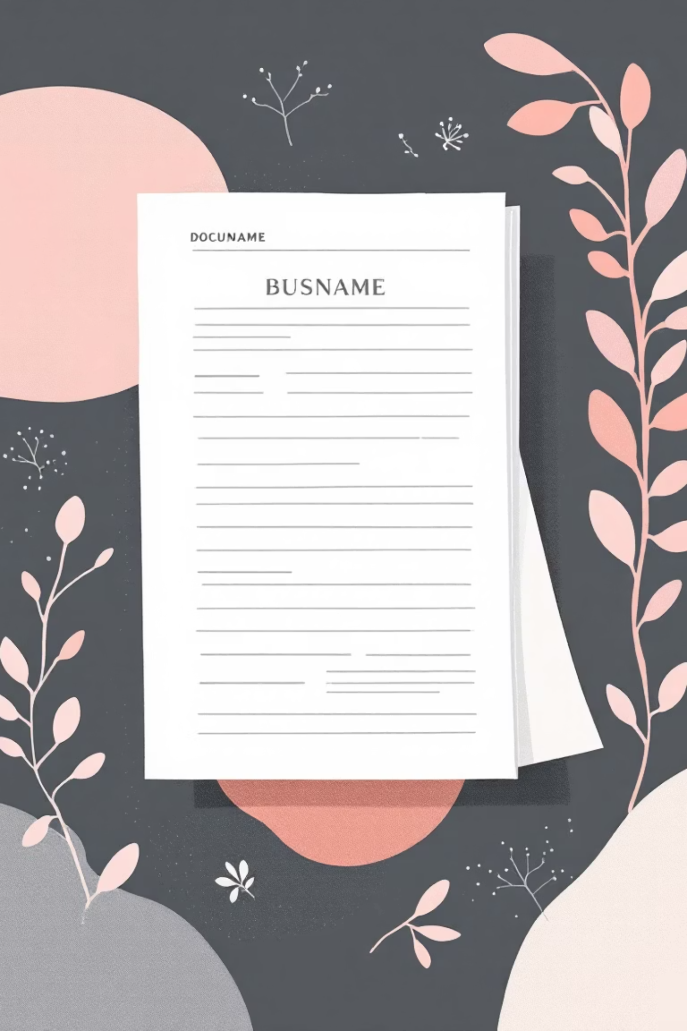
Styles Group: Consistent Formatting Made Easy
01
02
Apply Predefined Styles
Create Custom Styles
Use built-in styles like headings, titles, and subtitles for instant professional formatting.
Design and save your own formatting combinations for brand consistency and efficiency.
03
Global Updates
Modify a style once and watch it update throughout your entire document automatically.
Game Changer: Ensures professional, consistent design while saving hours of manual formatting work.

Slide 6

Editing Group: Find, Replace, and Select Efficiently
Powerful Editing Tools
Find & Replace
Locate and replace words or phrases instantly across entire documents, saving manual search time.
Smart Selection
Select all content, specific objects, or text parts with precision for bulk operations.
Collaboration Ready: Insert comments and track changes for seamless teamwork and document review processes.

Slide 7

Why the Home Tab is Your Productivity Hub
Centralized Access
Universal Design
All frequently used tools in one convenient location, eliminating menu hunting and workflow interruptions.
Visual commands support both beginners learning the basics and power users working at speed.
Time Saver
Reduces navigation time and cognitive load, letting you focus on content creation rather than tool location.

Slide 8





Practical Example: Formatting a Report
Clipboard Group
Copy research content from multiple sources and organize it efficiently in your document.
Font Group
Apply bold headings and highlight key statistics to draw reader attention to critical points.
Paragraph Group
Structure sections with proper alignment, create numbered recommendations, and organize findings in lists.
Styles Group
Apply consistent heading styles for a polished, professional appearance that impresses stakeholders.
Editing Group
Use Find & Replace to standardize terminology and ensure accuracy across the entire document.

Slide 9

Tips for Mastering the Home Tab
1
Format Painter Mastery
Double-click Format Painter to apply the same formatting to multiple sections without re-selecting the tool.
2
Custom Style Creation
Create and save custom styles that match your organization's branding for consistent, professional documents.
3
Find & Replace Power
Use wildcards and advanced options in Find & Replace to fix complex formatting errors across large documents.
4
Keyboard Shortcuts
Learn Alt + H + key combinations to access Home tab tools instantly without mouse navigation.

Slide 10

Master the Home Tab, Master Your Documents
5
80%
Essential Groups
Time Savings
Each serving a unique purpose in document creation and editing workflows.
Users report significant efficiency gains after mastering Home tab tools and shortcuts.
"Familiarity with these five groups transforms you from a basic user into a Word power user, boosting both efficiency and document quality."
Start Today: Begin exploring each group systematically to unlock Microsoft Word's full potential and elevate your document creation skills.

